Slide 2
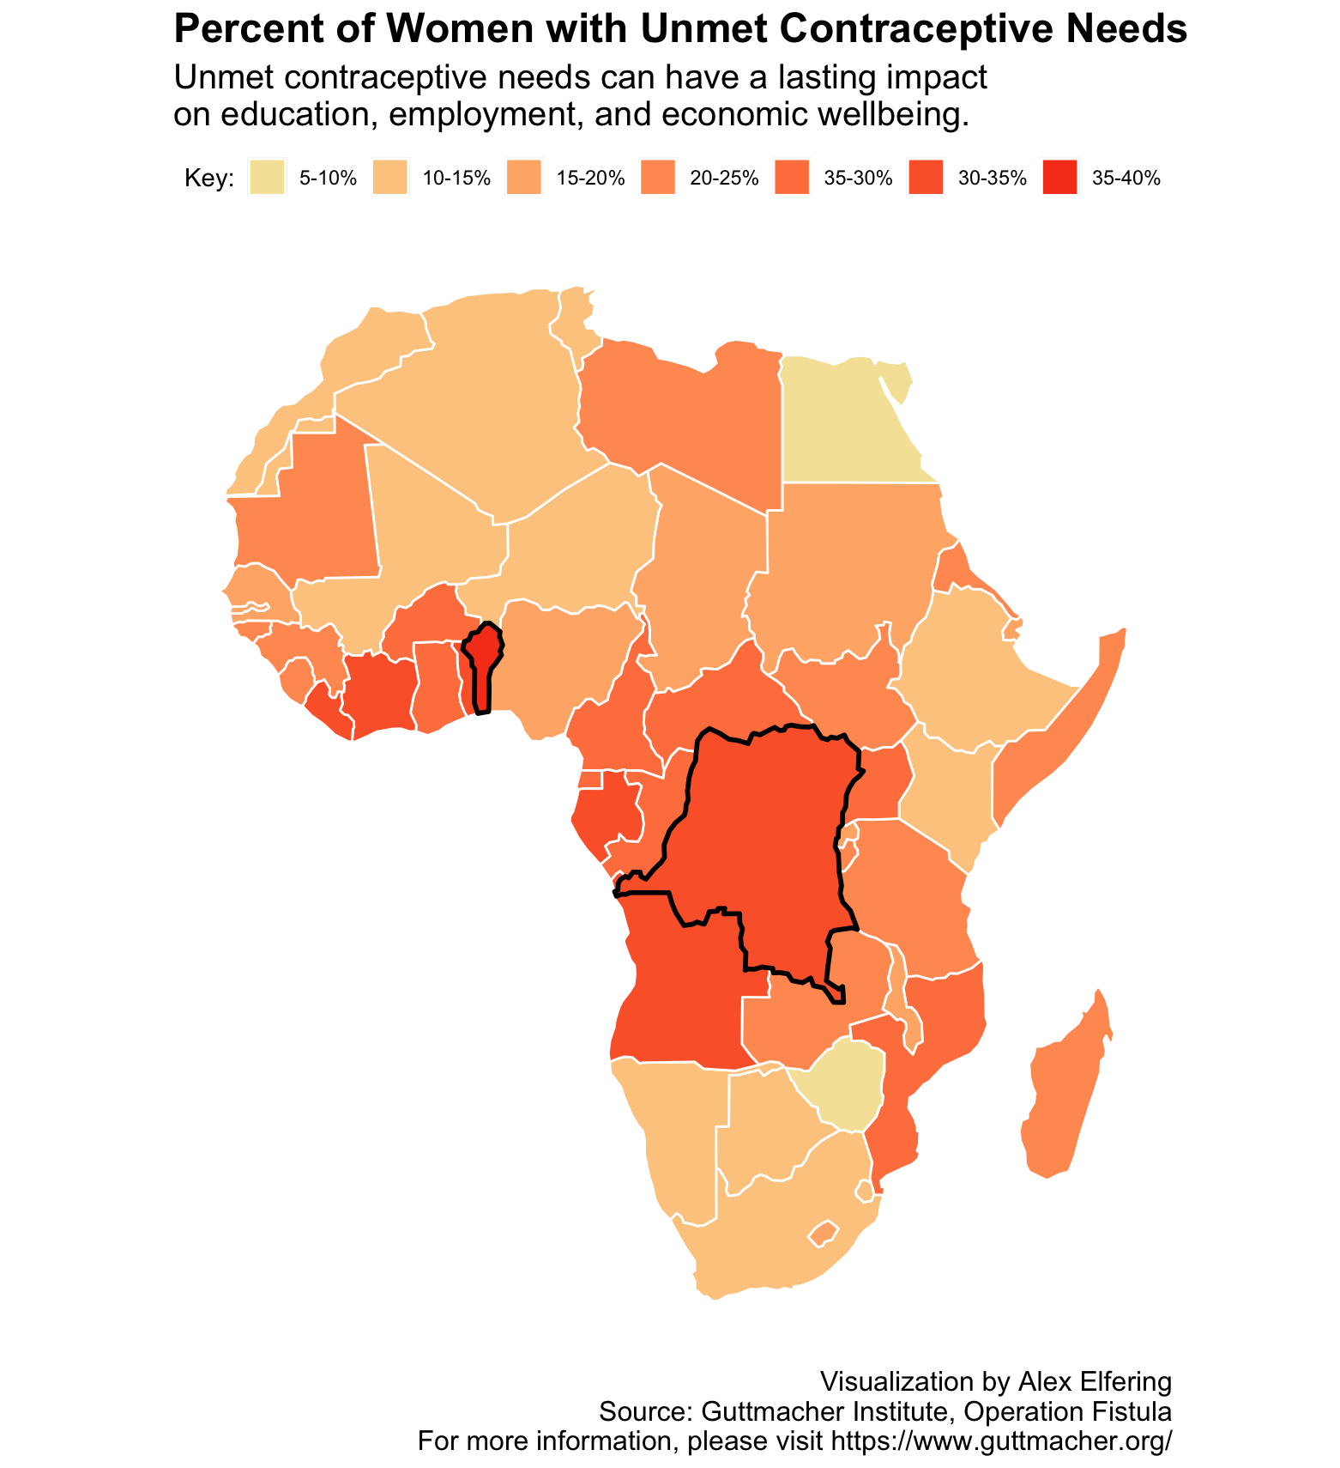
Central and Southwestern African countries have the highest rates, particularly Benin and the Dem. Republic of the Congo.

